Slide 1
Handimatronics:
Controlling Robots with Your Hand
Mikey and Kevin

Slide 2
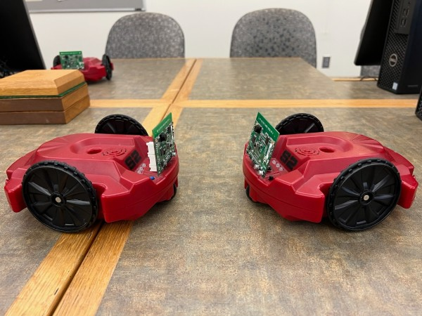
Presentation Outline
Project Overview
Optical Flow
How does it work?
Limitations and Future improvements
Gesture Recognition
How does it work?
Limitations and Future Improvements
Live Demo
Live Inputs with Direction and Gesture Outputs on Mac
Live Robot Control
Q&A
Figure 1: MyroC Scribbler Robots

Slide 3
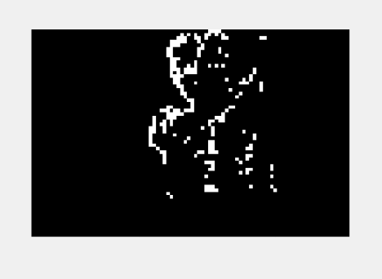
Presentation Outline
Project Overview
Optical Flow
How does it work?
Limitations and Future improvements
Gesture Recognition
How does it work?
Limitations and Future Improvements
Live Demo
Live Inputs with Direction and Gesture Outputs on Mac
Live Robot Control
Q&A
Figure 1: Failed optical flow logical matrix

Slide 4
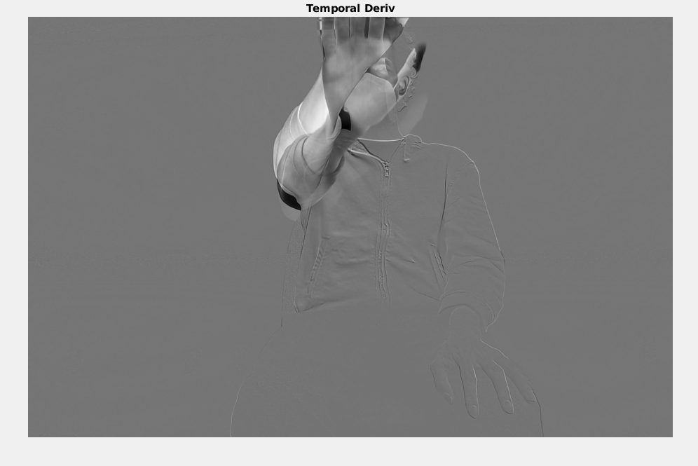
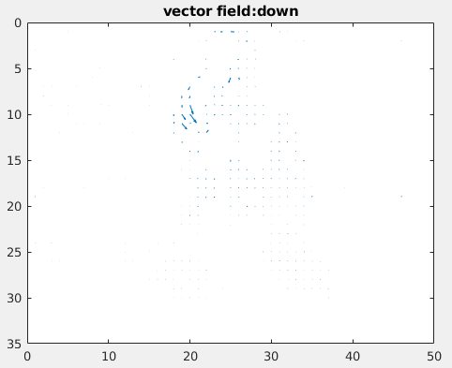
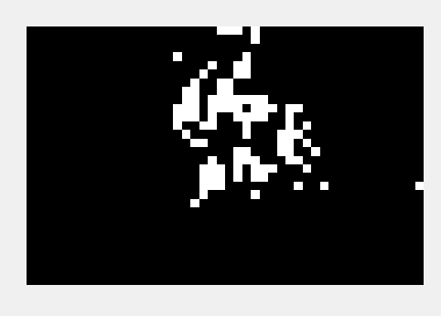
Optical Flow in a Nutshell
Move
Solve dervatives
Approximate Ax = b
Create vector field
Find angle
Describe motion!
Figure 2: Logical Matrix of down
Figure 1: Temporal Dervative of down
Figure 3: Vector Field of down

Slide 5
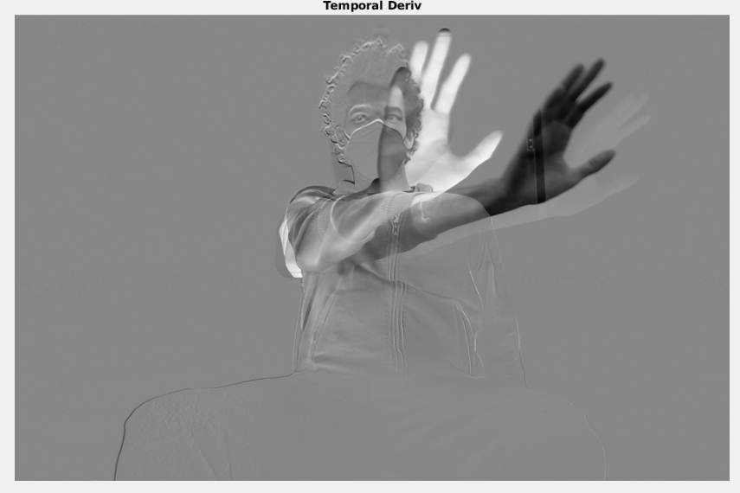
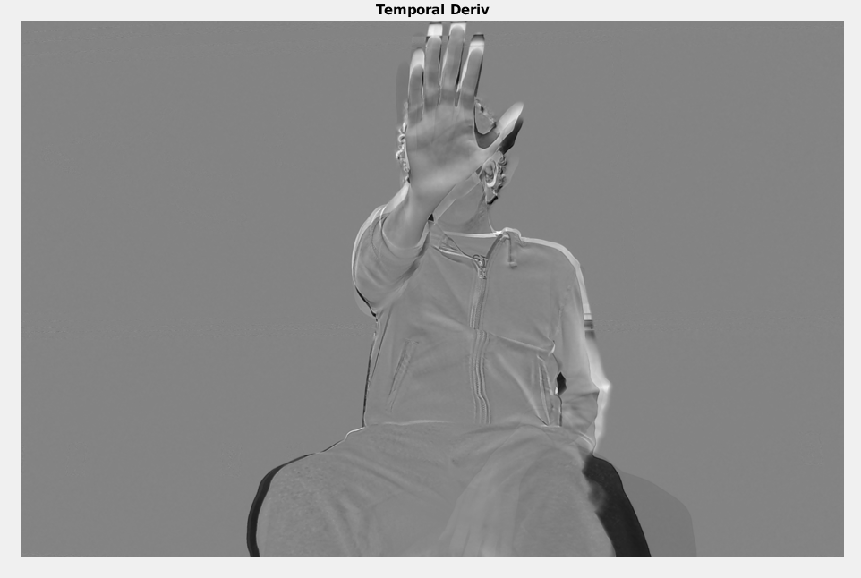
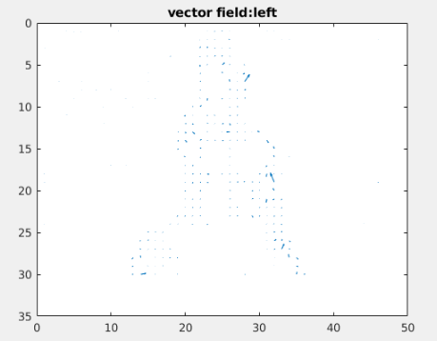
Limitations of Optical flow
Figure 3: Failed left temporal derivative
To sum:
Extraneous motion is bad
Small changes in motion
Accuracy between cameras
Small amount of motion descriptors
Figure 1: Failed down temporal derivative
Figure 2: Failed down vector field
Notes:
Figure 3 is supposed to be left and thought it was right

Slide 6
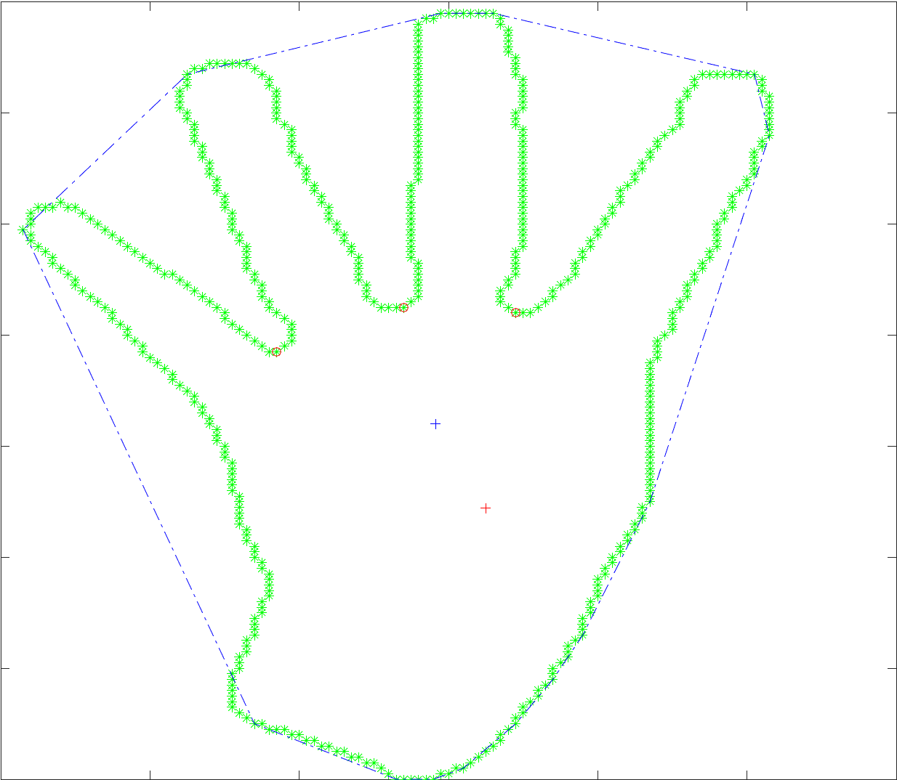
Presentation Outline
Project Overview
Optical Flow
How does it work?
Limitations and Future improvements
Gesture Recognition
How does it work?
Limitations and Future Improvements
Live Demo
Live Inputs with Direction and Gesture Outputs on Mac
Live Robot Control
Q&A
Figure 1: Sample Gesture for 4

Slide 7
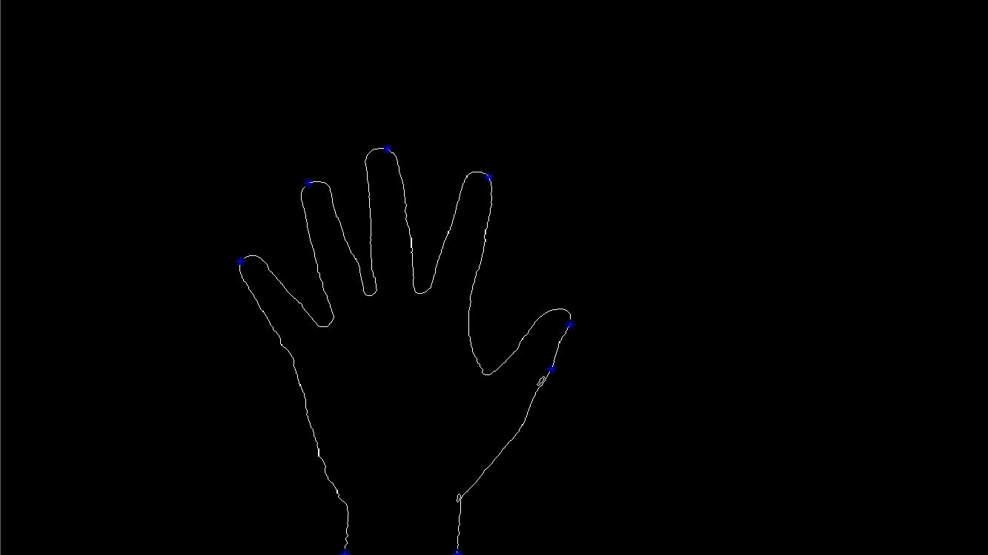
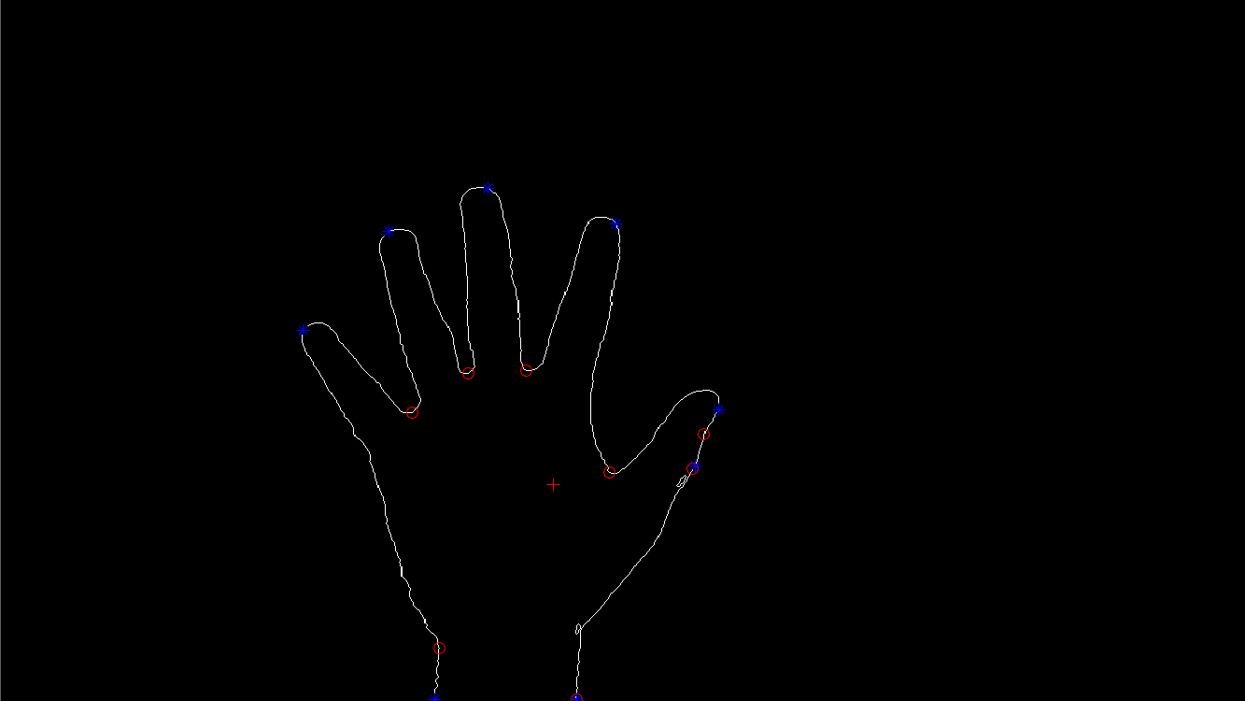
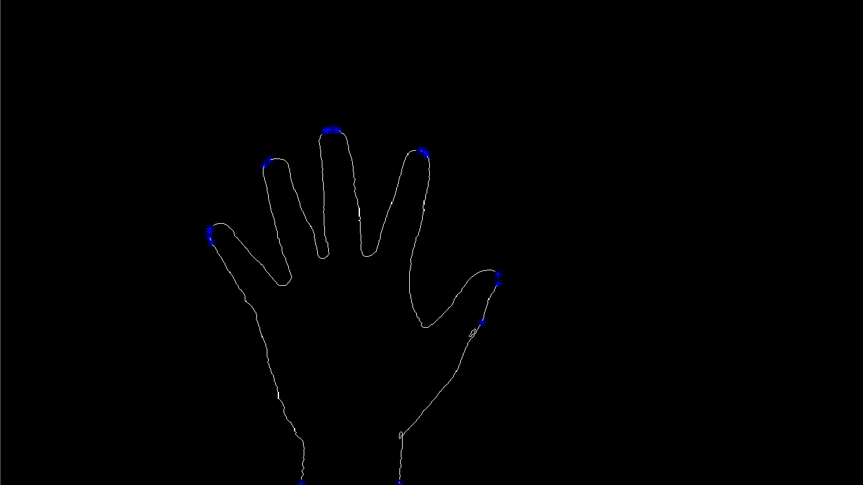

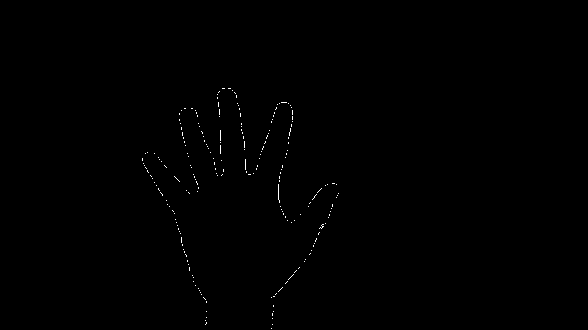
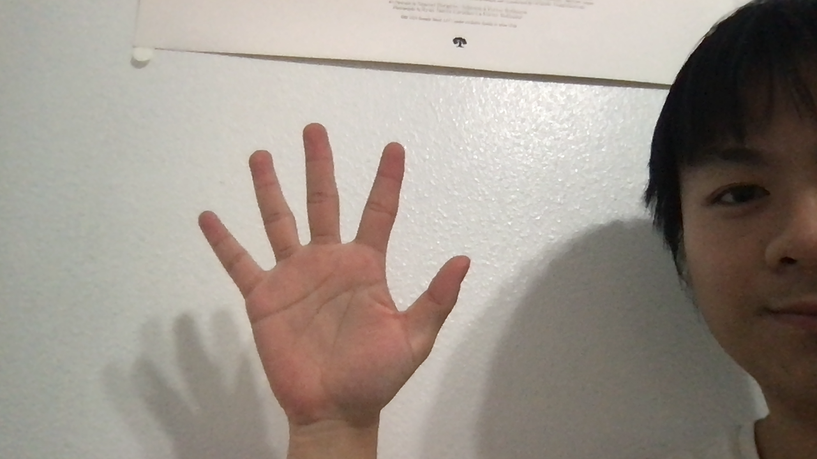
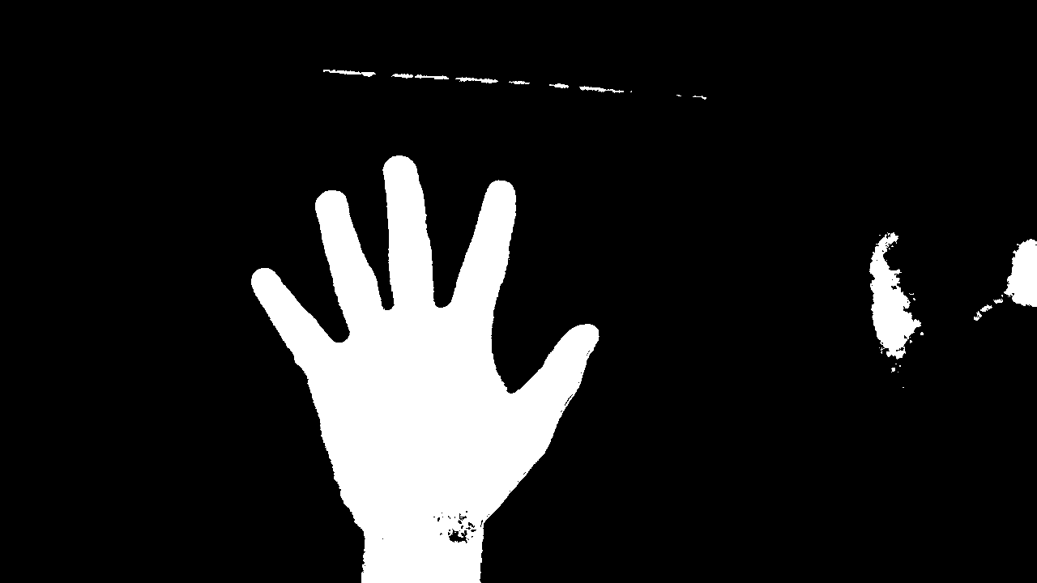
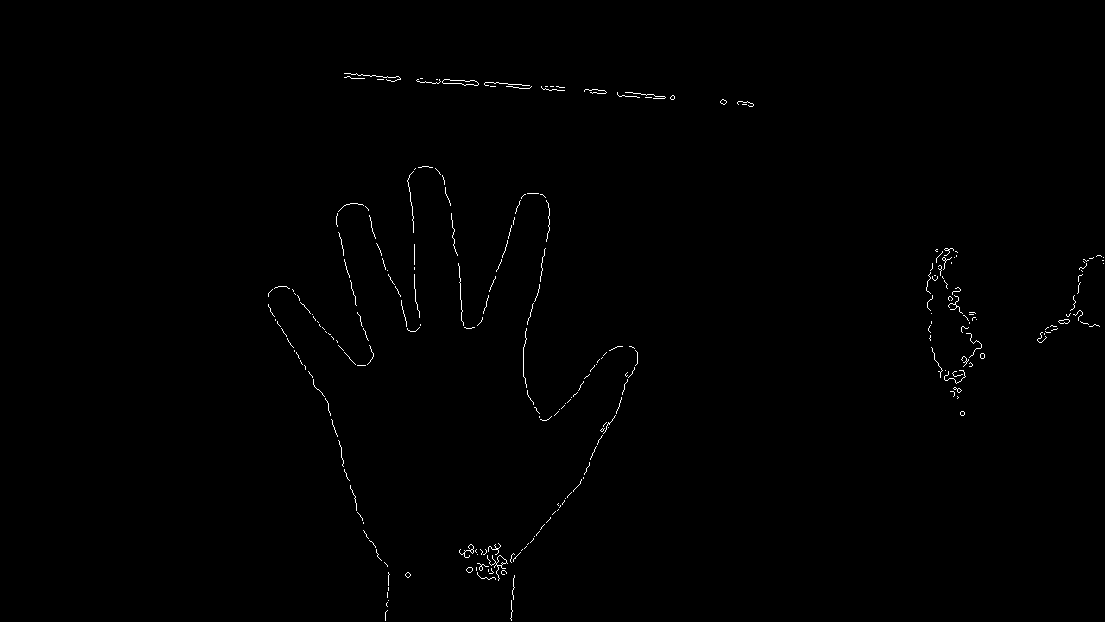
Gesture Recognition - How does it work?
take a photo!
find skin!
find edge!
find largest set!
find convex hull!
find defects!
count!
take a photo!
find skin!
find edge!
find largest set!
find convex hull!
find defects!
count!
take a photo!
find skin!
find edge!
find largest set!
find convex hull!
find defects!
count!
take a photo!
find skin!
find edge!
find largest set!
find convex hull!
find defects!
count!
take a photo!
find skin!
find edge!
find largest set!
find convex hull!
find defects!
count!
take a photo!
find skin!
find edge!
find largest set!
find convex hull!
find defects!
count!
take a photo!
find skin!
find edge!
find largest set!
find convex hull!
find defects!
count!
Figure: Procedure Example

Slide 8
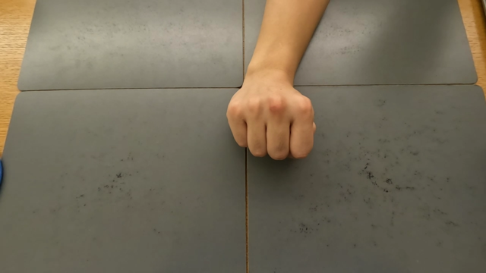
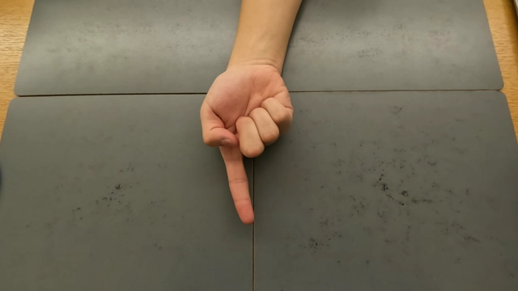

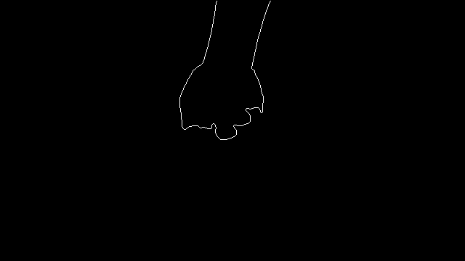
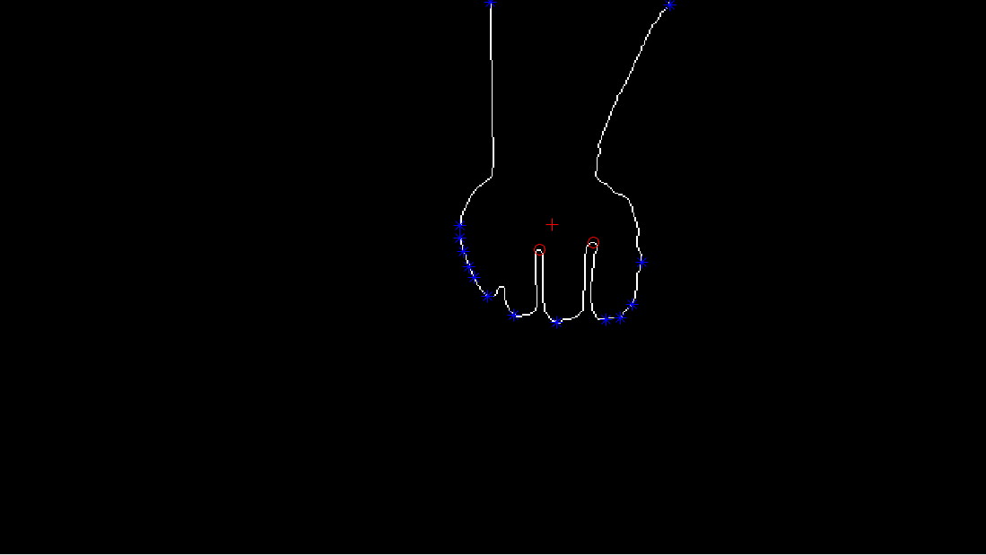
Limitation 1: Shadow & Light / Skin Recognition
Figure: Failed Example 1 (zero as three)
Figure: Failed Example 2 (one as zero)

Slide 9
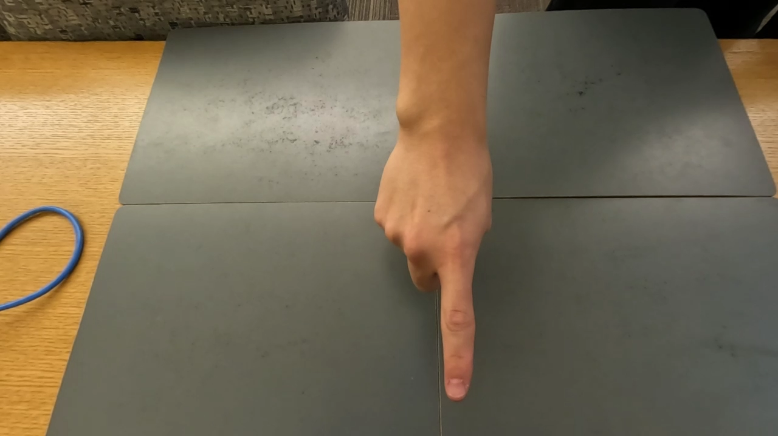
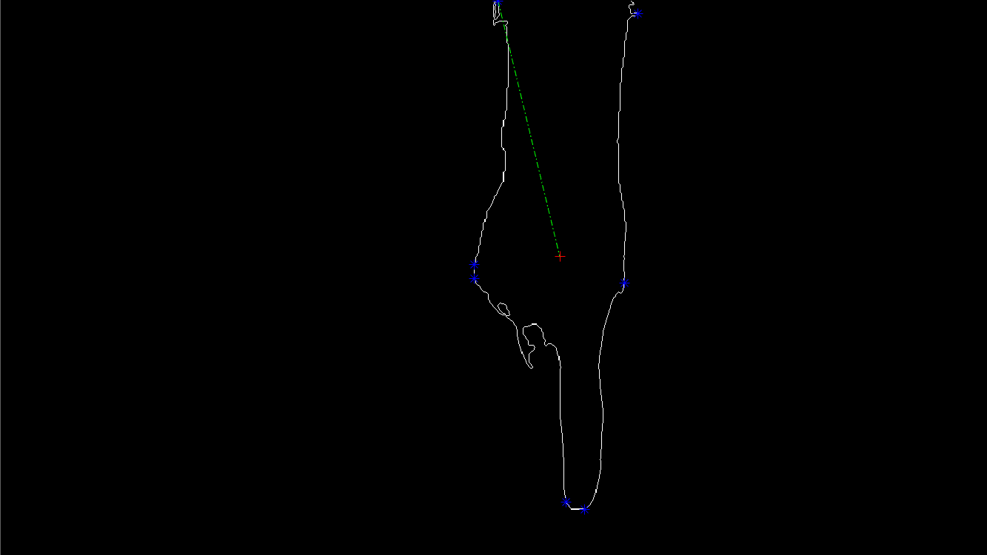
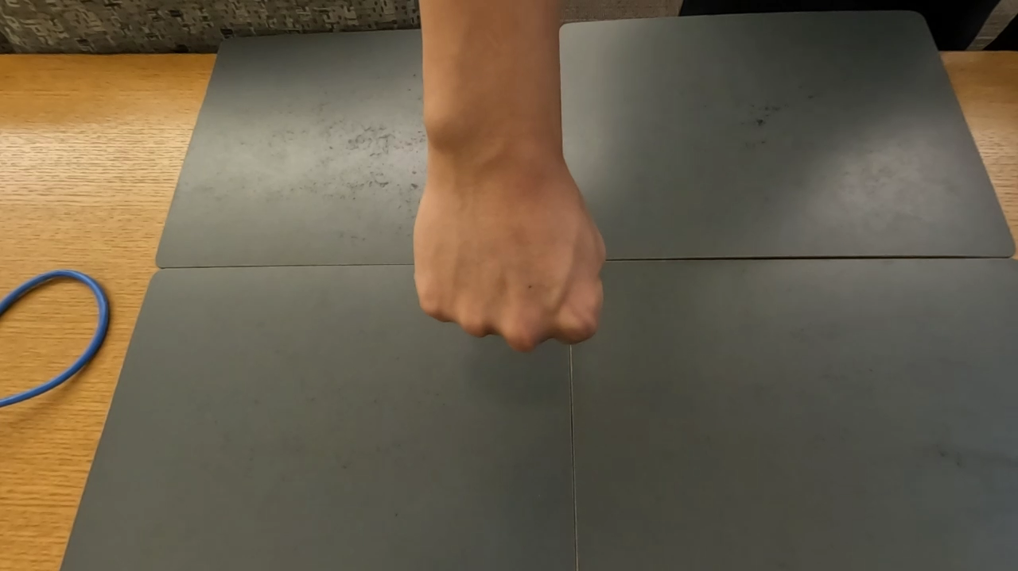
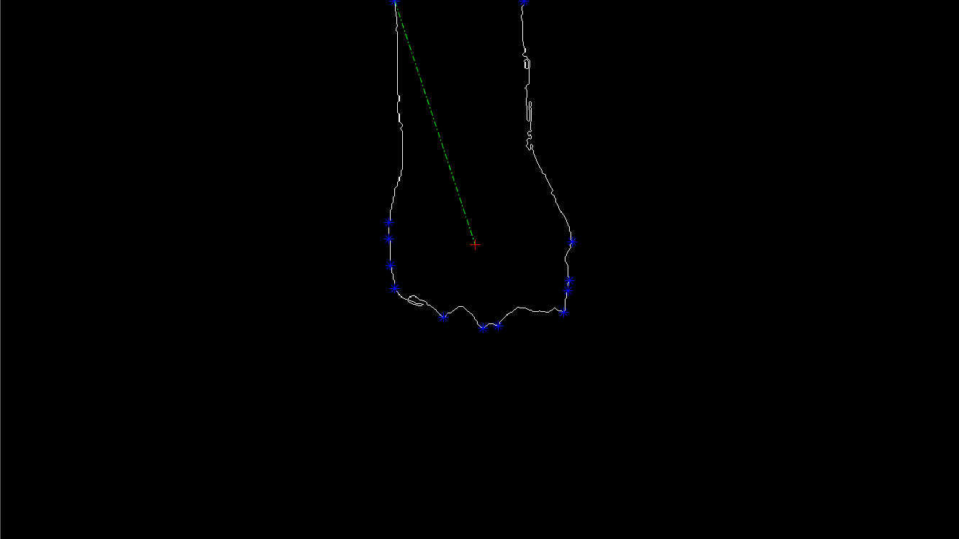
Limitation 2: Telling 0 and 1 Apart
Challenge:
No valid defect points in both cases
Current Method:
Assuming the farthest vertex is a finger tip and then thresholding the distance from palm center to that vertex
Figure: Failed Example 3 (zero as one)
Figure: Failed Example 4 (one as zero (again))

Slide 10
Presentation Outline
Project Overview
Optical Flow
How does it work?
Limitations and Future improvements
Gesture Recognition
How does it work?
Limitations and Future Improvements
Live Demo
Live Inputs with Direction and Gesture Outputs on Mac
Live Robot Control
Q&A

Slide 11
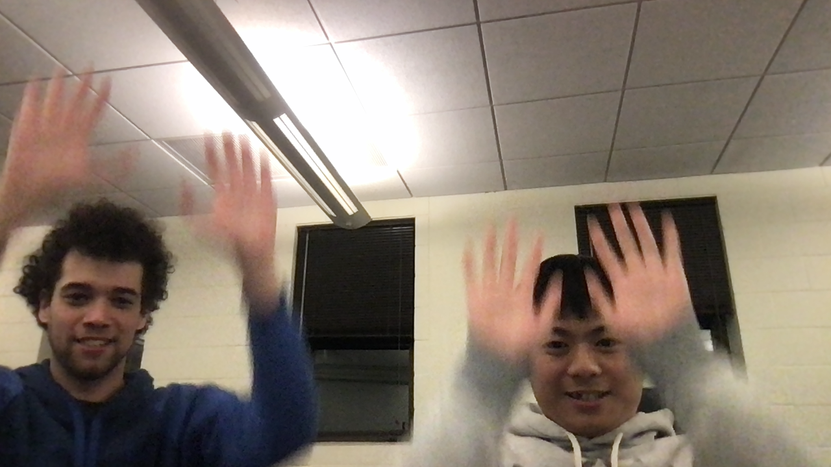
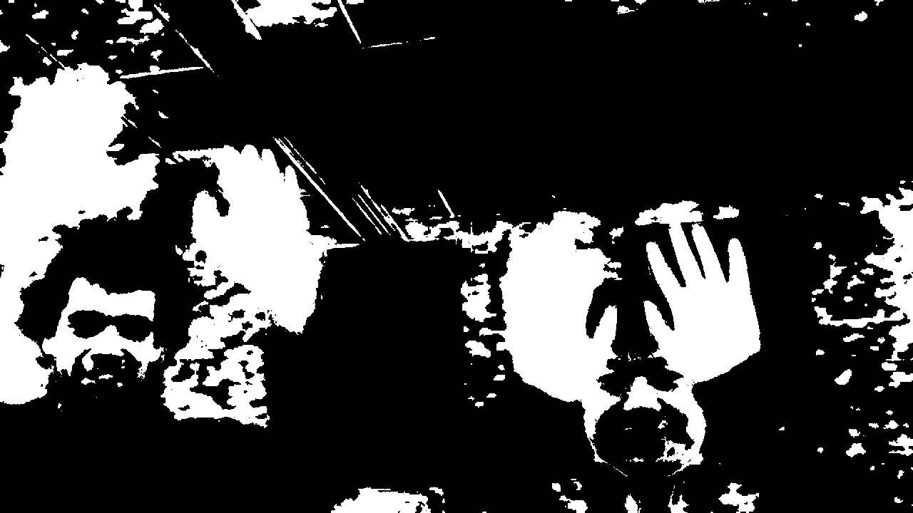
Q&A

Slide 12
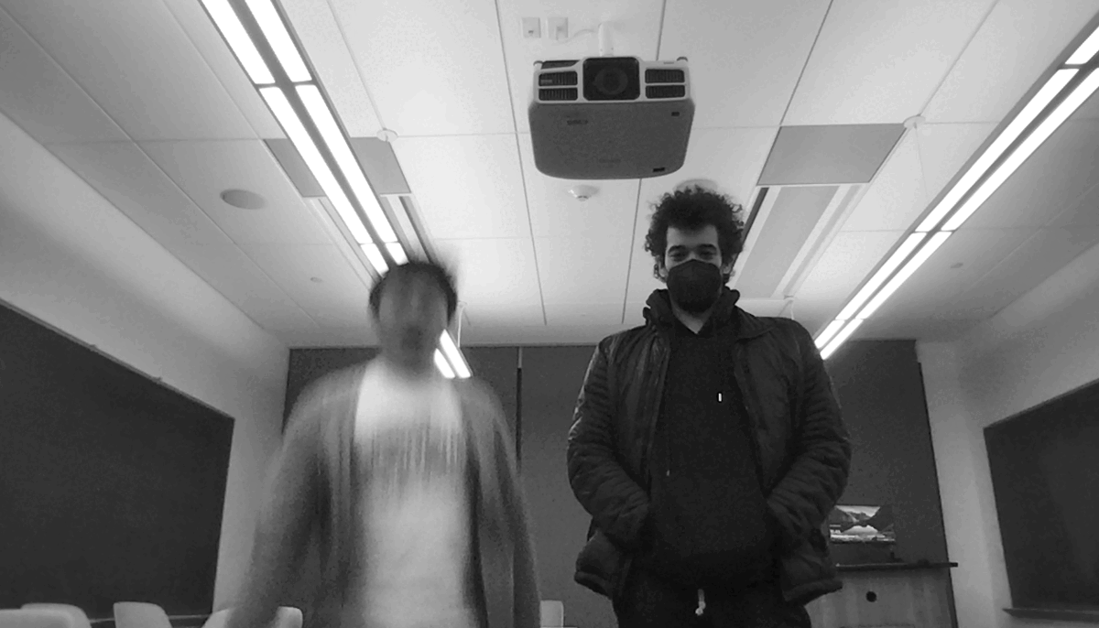
Thank you!!

